Slide 1
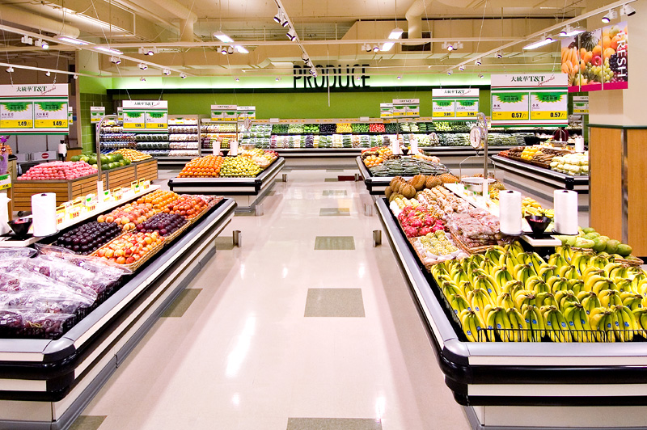
FRESHCO HYPERMARKET
Tejashree M L

Slide 2




Order Level Analysis
Completion Level Analysis
Customer Level Analysis
Delivery Level Analysis

Slide 3
Order Level Analysis Order distribution at slot and delivery area level
In this chart we can see how order volumes vary by location and time of day, here we can also see that:
HSR Layout and ITI layout are the areas where most of the orders are placed and Akshaya Nagar and Arekere have consistently low order volumes.
Also, most of the orders are placed in Afternoon making it the peak hours for order placement and late nights have less order placement.

Slide 4
Order Level Analysis The areas having highest increase in monthly orders
In this chart we can see which area has highest orders placement in month wise
Again here, we can see that HSR Layout, Harlur and ITI layout have highest increase in monthly order placements.
And the months that has highest orders are July, August and September with order frequency more than 500.

Slide 5
Order Level Analysis Delivery charges % and Discount % at slot and month level
This chart shows the percentage of delivery charges distributed across different times
In the above chart we can see that delivery charge % are very high during Late night slots across all months and it peaks in February
This chart shows the percentage of discount distributed across different times
In the above chart we can see August has the highest discount percentages across all slots, particularly in the Night (22.11%) and Afternoon (21.50%) slots.
And,customers have got lesser discounts in late night slots.

Slide 6
Completion Rate Analysis Completion rate at slot vs day of the week level
In the above chart, we can see that Sunday has the highest overall completion rate (99.86%), with the Evening slot reaching a perfect 100%.

Slide 7
Completion Rate Analysis Completion rate at drop area level
In the above chart, we can see that the completion rate is very low i.e., 0% in Cox town and Whitefield.

Slide 8
Completion Rate Analysis Completion rate at no. of products ordered level
In the above chart, we can see the highest completion rate, 100.00%, is when customers have ordered 20+ orders.

Slide 9
Customer Level Analysis Completion rate at source level
The above chart notifies that, completion rate at Organic acquisition source is higher and Offline Campaign is the lowest.

Slide 10
Customer Level Analysis Aggregated LTV at customer acquisition source level
The above chart notifies that, Organic has the highest aggregated customer LTV, whereas Instagram has the lowest LTV.
January has the highest aggregated customer LTV, whereas September has the lowest LTV.

Slide 11
Customer Level Analysis Average Revenue per order at different customer acquisition source level and month level
The above chart notifies that, highest revenue per order is by Snapchat and the lowest is by Instagram
January has the highest average revenue per order, whereas September has the lowest.

Slide 12
Patten observed in order rating across different scenarios.
The first chart notifies that,the 5-star rating is consistently high across all time slots and lowest rating are given to late night orders.
2nd chart notifies that, the lowest delivery charges have most 5-star rating.
3rd chart notifies that, the orders with lowest discount has the highest rating
4th chat notifies that, the customer has provided 5-star rating for ordered products which are less than 5.

Slide 13
Delivery Level Analysis Average overall delivery time at month and delivery area level
The above chart tells us that February month has lowest delivery time and May has highest delivery time.
Also, we can see that delivery area Mahadevapura has longest delivery time compared to other areas.

Slide 14
Delivery Level Analysis Average overall delivery time at month and delivery area level
In the above chart, we can observe weekend delivery takes longer time than weekdays.

Slide 15
Delivery Level Analysis Average overall delivery time at slot level
In the above chart, we can see that Late night slots has lesser delivery time, whereas Morning, evening afternoon takes more time for delivery.

Slide 16
Delivery Level Analysis Delivery Charges across slots and delivery areas
In the above chart, we can see that the delivery charges are high for the customers who orders at afternoon slot., where late night slots have less delivery charges.
In the other chart, we can observe that Mahadevapura has longer delivery time compare to other areas.

Slide 17
THANK YOU

